Slide 1

AI Screening Assistant
Gen AI Bootcamp - Capstone​ Project
Presented by: Emmanuelle Frappier

Slide 2
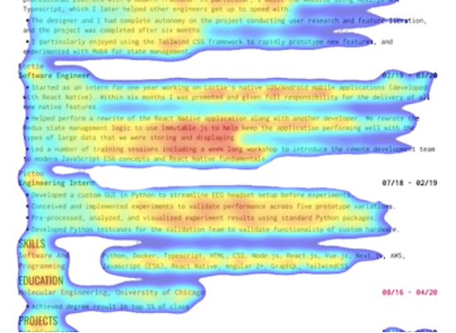
The Problem
Volume Overload: HR spends hours reviewing hundreds of documents manually.
Inconsistent Screening: Different recruiters apply different criterias, leading to unfair choices.
Unconscious Bias: Human fatigue and subjectivity affect fairness.
Slow Time-to-Hire: Delays in screening mean losing top talent to competitors.

Slide 3
The Objective
To build an intelligent and transparent system that automates analysis, ensures fairness, and matches candidates based on semantic skills, not just keywords.

Slide 4

Proposed Solution
An AI-Powered Screening Assistant that brings speed and intelligence to hiring.
Automated Analysis: Extracts key info instantly using NLP.
Semantic Matching: Compares candidate skills to job descriptions using vector embeddings.
Smart Ranking: Scores candidates by relevance.
Insightful Summaries: Generates "Strengths & Gaps" analysis.

Slide 5
Program Architecture
User Input: Upload CVs + Job Description.
Extraction: Parse text from documents.
Embedding: Generate vectors (Job + CVs).
Storage: Save to Pinecone Vector DB.
Search: Perform semantic similarity search.
Analysis: Rank candidates & LLM summary.
Visualization: Display charts & statistics.
Export: Download results to Excel.

Slide 6
















Technologies Used
Core Logic
AI & NLP
Vector DB
Python, Pandas and NumPy
LlamaIndex and HuggingFace
Pinecone
Frontend
Visualization
Control
Streamlit
Matplotlib and Seaborn
GitHub

Slide 7
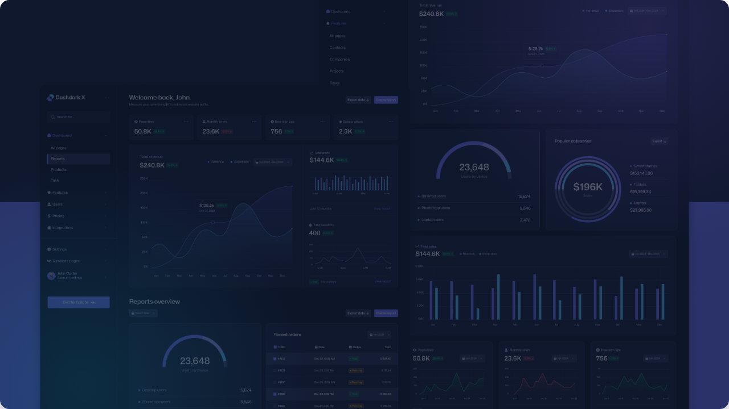

Live Demo
Experience the AI Screening Assistant in Action.

Slide 8




Challenges & Solutions
Test Data
Matching Logic
Prompt Design
Challenge: Acquiring diverse, realistic CVs for robust testing.
Solution: Used synthetic data generation and anonymized public datasets.
Challenge: Text search wasn't enough; needed to understand "skills" and "fit".
Solution: Tuned embedding models to capture semantic meaning over keywords.
Challenge: LLM hallucinations in summaries.
Solution: Strict prompt engineering to ground the LLM solely in the retrieved context.

Slide 9




Future Roadmap
Scheduling
LinkedIn
Analytics
Templates
Automated interview scheduling via calendar API integration.
Direct integration to fetch profiles and expand candidate pool.
Advanced dashboard for DEI metrics and hiring funnel insights.
Pre-built JD templates to standardize requirements.

Slide 10


Conclusion
Transforming Recruitment
The AI Screening Assistant proves that we can modernize the hiring pipeline without losing the human touch.
Efficiency: Drastically reduces initial screening time.
Quality: surfaces candidates based on merit and skill.
Fairness: Provides a standardized, bias-reduced evaluation.

Slide 11

Questions?

Slide 12
Thank You

